Slide 1
Collection Framework

Slide 2
Collections: Aren't they just arrays?
In procedural languages, arrays are often the only way to represent groups of data
Array provides a mechanism for memory management
Programmer must provide algorithms for managing the array
Arrays are, generally speaking, not Object Oriented
They are not cohesive
The array and the code to manage the array are not an single unit

Slide 3
Introduction to Collections
A collection — sometimes called a container — is simply an object that groups multiple elements into a single unit.
Collections are used to store, retrieve, manipulate, and communicate aggregate data.
It defines a collections framework as “a unified architecture for representing and manipulating collections, allowing them to be manipulated independent of the details of their representation.”

Slide 4
What is Collection Framework
A collections framework is a unified architecture for representing and manipulating collections. All collections frameworks contain the following:
• Interfaces: These are abstract data types that represent collections. Interfaces allow collections to be manipulated independently of the details of their representation. In object-oriented languages, interfaces generally form a hierarchy.
• Implementations: These are the concrete implementations of the collection interfaces. In essence, they are reusable data structures.
• Algorithms: These are the methods that perform useful computations, such as searching and sorting, on objects that implement collection interfaces. The algorithms are said to be polymorphic: that is, the same method can be used on many different implementations of the appropriate collection interface. In essence, algorithms are reusable functionality.

Slide 5
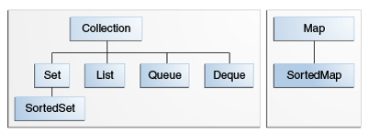
Core Collection Interfaces
These interfaces allow collections to be manipulated independently of the details of their representation.
Core collection interfaces are the foundation of the Java Collections Framework.

Slide 6
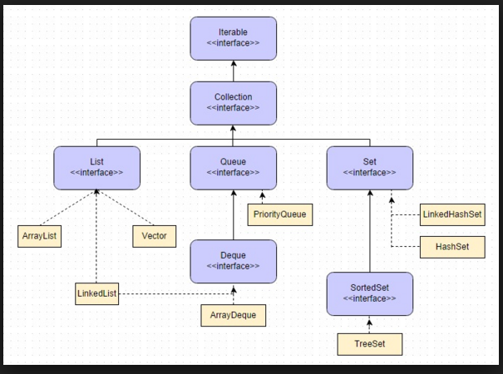
Collection Framework - Hierarchy

Slide 7
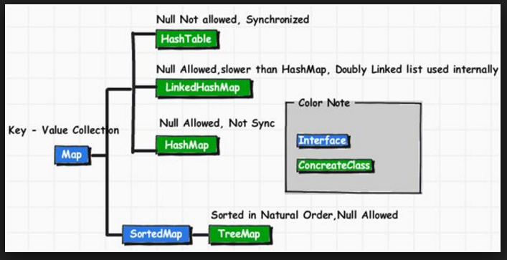
Collection Framework - Hierarchy

Slide 8
The Collection Interface
public interface Collection<E> extends Iterable<E> {
// Basic operations
int size();
boolean isEmpty();
boolean contains(Object element);
boolean add(E element); //optional
boolean remove(Object element); //optional
Iterator<E> iterator();
// Bulk operations
boolean containsAll(Collection<?> c);
boolean addAll(Collection<? extends E> c); //optional
boolean removeAll(Collection<?> c); //optional
boolean retainAll(Collection<?> c); //optional
void clear(); //optional
// Array operations
Object[] toArray();
<T> T[] toArray(T[] a);
}

Slide 9
Traversal of Collection
      for-each Construct
The for-each construct allows you to concisely traverse a collection or array using a for loop . The following code uses the for-each construct to print out each element of a collection on a separate line.
for (Object o : collection)
System.out.println(o);
      Iterators
An Iterator is an object that enables you to traverse through a collection and to remove elements from the collection selectively, if desired. You get an Iterator for a collection by calling its iterator method. The following is the Iterator interface.
public interface Iterator<E> {
boolean hasNext();
E next();
void remove(); //optional
}

Slide 10
Set Interface
Set — a collection that cannot contain duplicate elements.
public interface Set<E> extends Collection<E> {
// Basic operations
int size();
boolean isEmpty();
boolean contains(Object element);
boolean add(E element); //optional
boolean remove(Object element); //optional
Iterator<E> iterator();
// Bulk operations
boolean containsAll(Collection<?> c);
boolean addAll(Collection<? extends E> c); //optional
boolean removeAll(Collection<?> c); //optional
boolean retainAll(Collection<?> c); //optional
void clear(); //optional
// Array Operations
Object[] toArray();
<T> T[] toArray(T[] a);
}
Note: nothing added to Collection interface – except no duplicates allowed

Slide 11
The List Interface
List — an ordered collection (sometimes called a sequence). Lists can contain duplicate elements.
public interface List<E> extends Collection<E> {
// Positional access
E get(int index);
E set(int index, E element); //optional
boolean add(E element); //optional
void add(int index, E element); //optional
E remove(int index); //optional
boolean addAll(int index,
Collection<? extends E> c); //optional
// Search
int indexOf(Object o);
int lastIndexOf(Object o);
// Iteration
ListIterator<E> listIterator();
ListIterator<E> listIterator(int index);
// Range-view
List<E> subList(int from, int to);
}

Slide 12
List Iterator
The three methods that ListIterator inherits from Iterator (hasNext, next, and remove) do exactly the same thing in both interfaces.
The hasPrevious and the previous operations are exact analogues of hasNext and next.
The former operations refer to the element before the (implicit) cursor, whereas the latter refer to the element after the cursor.
The previous operation moves the cursor backward, whereas next moves it forward.

Slide 13
List Iterator..
public interface ListIterator<E> extends Iterator<E> {
boolean hasNext();
E next();
boolean hasPrevious();
E previous();
int nextIndex();
int previousIndex();
void remove(); //optional
void set(E e); //optional
void add(E e); //optional
}

Slide 14
List Algorithms
Most polymorphic algorithms in the Collections class apply specifically to List. Having all these algorithms at your disposal makes it very easy to manipulate lists. Here's a summary of these algorithms, which are described in more detail in the Algorithms section.
• sort — sorts a List using a merge sort algorithm, which provides a fast, stable sort. (A stable sort is one that does not reorder equal elements.)
• shuffle — randomly permutes the elements in a List.
• reverse — reverses the order of the elements in a List.
• rotate — rotates all the elements in a List by a specified distance.
• swap — swaps the elements at specified positions in a List.
• replaceAll — replaces all occurrences of one specified value with another.
• fill — overwrites every element in a List with the specified value.
• copy — copies the source List into the destination List.
• binarySearch — searches for an element in an ordered List using the binary search algorithm.
• indexOfSubList — returns the index of the first sublist of one List that is equal to another.
• lastIndexOfSubList — returns the index of the last sublist of one List that is equal to another.

Slide 15
List implementations
List is an interface; you can’t say new List ( )
There are two implementations:
  LinkedList gives faster insertions and deletions
  ArrayList gives faster random access
It’s poor style to expose the implementation, so:
Good: List list = new LinkedList ( );
Bad: LinkedList list = new LinkedList ( );

Slide 16
List Implementation
ArrayList
low cost random access
high cost insert and delete
array that resizes if need be
LinkedList
sequential access
low cost insert and delete
high cost random access

Slide 17
LinkedList Class Methods
The list is sequential, so access it that way
ListIterator listIterator()
ListIterator knows about position
use add() from ListIterator to add at a position
use remove() from ListIterator to remove at a position
LinkedList knows a few things too
void addFirst(Object o), void addLast(Object o)
Object getFirst(), Object getLast()
Object removeFirst(), Object removeLast()

Slide 18
The Map Interface
A Map is an object that maps keys to values.
A map cannot contain duplicate keys: Each key can map to at most one value.
It models the mathematical function abstraction.
The Map interface includes methods for basic operations (such as put, get, remove, containsKey, containsValue, size, and empty), bulk operations (such as putAll and clear), and collection views (such as keySet, entrySet, and values).

Slide 19
Map Interface...
public interface Map<K,V> {
// Basic operations
V put(K key, V value);
V get(Object key);
V remove(Object key);
boolean containsKey(Object key);
boolean containsValue(Object value);
int size();
boolean isEmpty();
// Bulk operations
void putAll(Map<? extends K, ? extends V> m);
void clear();
// Collection Views
public Set<K> keySet();
public Collection<V> values();
public Set<Map.Entry<K,V>> entrySet();
// Interface for entrySet elements
public interface Entry {
K getKey();
V getValue();
V setValue(V value);
}
}

Slide 20
The SortedSet Interface
SortedSet — a Set that maintains its elements in ascending order.
public interface SortedSet<E> extends Set<E> {
// Range-view
SortedSet<E> subSet(E fromElement, E toElement);
SortedSet<E> headSet(E toElement);
SortedSet<E> tailSet(E fromElement);
// Endpoints
E first();
E last();
// Comparator access
Comparator<? super E> comparator();
}

Slide 21
The SortedMap Interface
SortedMap — a Map that maintains its mappings in ascending key order.
public interface SortedMap<K, V> extends Map<K, V>{
SortedMap<K, V> subMap(K fromKey, K toKey);
SortedMap<K, V> headMap(K toKey);
SortedMap<K, V> tailMap(K fromKey);
K firstKey();
K lastKey();
Comparator<? super K> comparator();
}

Slide 22
Range View and End Point
// Range-view
SortedSet<E> subSet(E fromElement, E toElement);
SortedSet<E> headSet(E toElement);
SortedSet<E> tailSet(E fromElement);
// Endpoints
E first();
E last();

Slide 23
Which Collection I should use?
There are various factors that can be considered when selecting an appropriate collection for a particular problem. These factors are:
Ordering - Some sort of ordering in the elements. For example, sorted order, insertion order or no specific ordering.
Duplicates - May or may not want to allow duplicate elements in a collection.
Thread Safe - Ensure the safety of the elements in a collections in case there are multiple threads accessing it.
Key-Value pair - Store in key-value pairs.
Random Access - Instant retrieval of an element.

Slide 24
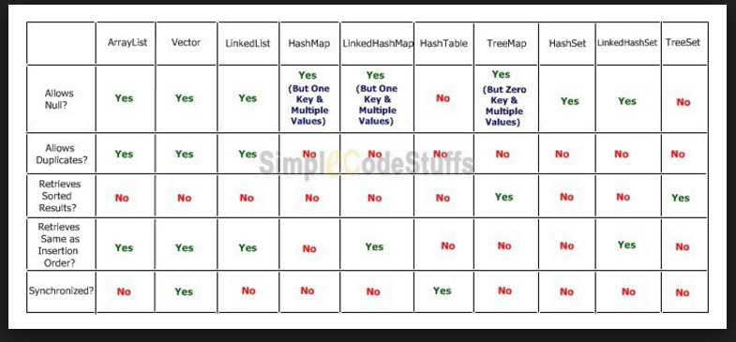
Comparision

Slide 25
Further references
http://docs.oracle.com/javase/tutorial/collections/interfaces/index.html

Slide 26
The End

